Slide 1
IMAGE SEGMENTATION
K-MEANS CLUSTERING

Slide 2
IMAGE SEGMENTATION
the classification of an image into different groups
an important step in image processing
if we want to analyze what’s inside the image
For example,
to find if there is a chair or person inside an indoor image
we may need image segmentation to separate objects
analyze each object individually to check what it is

Slide 3
IMAGE SEGMENTATION
usually serves as the pre-processing before pattern recognition
feature extraction,
and compression of the image
the process of partitioning a digital image into multiple distinct regions
containing each pixel(sets of pixels, also known as superpixels) with similar attributes.

Slide 4
IMAGE SEGMENTATION
Goal → to change the representation of an image into something that is more meaningful and easier to analyze
typically used to locate objects and boundaries (lines, curves, etc.) in images
the process of assigning a label to every pixel in an image
such that pixels with the same label share certain characteristics

Slide 5
IMAGE SEGMENTATION why important?
Autonomous Vehicles
they need sensory input devices like cameras, radar, and lasers
to allow the car to perceive the world around it
creating a digital map
Autonomous driving is not even possible without object detection which itself involves image classification/segmentation

Slide 6

IMAGE SEGMENTATION why important?

Slide 7
IMAGE SEGMENTATION why important?
Cancer
cancer can be fatal if we don’t identify it at an early stage
Detecting cancerous cell(s) as quickly as possible can potentially save millions of lives
The shape of the cancerous cells plays a vital role
in determining the severity of cancer
which can be identified using image classification algorithms

Slide 8
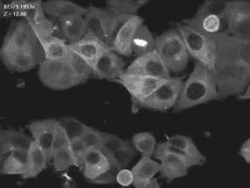
IMAGE SEGMENTATION why important?

Slide 9
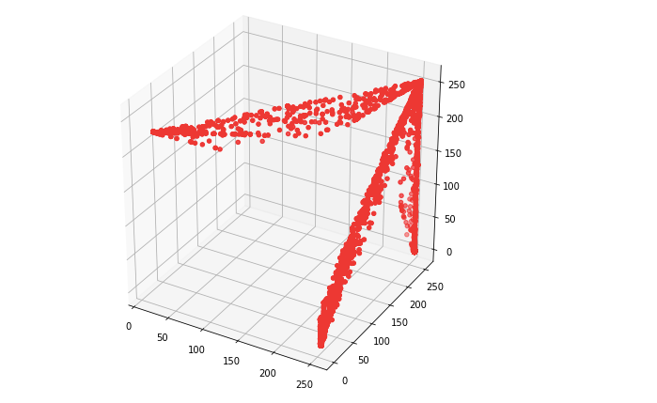

IMAGE SEGMENTATION
3 different colors which means 3 clusters/groups should be generated
From the plot → the data points are forming groups
some places in a graph are more dense
we can think as different colors’ dominance on the image

Slide 10
IMAGE SEGMENTATION MECHANISM
involves converting an image into a collection of regions of pixels
represented by a mask or a labelled image
By dividing an image into segments
we can process only the important segments of the image instead of processing the entire image

Slide 11
IMAGE SEGMENTATION MECHANISM
A common technique→ to look for abrupt discontinuities in pixel values, which typically indicate edges that define a region
Another common approach → to detect similarities in the regions of an image.
Some techniques that follow this approach are region growing, clustering, and thresholding.

Slide 12
IMAGE SEGMENTATION MECHANISM CLUSTERING BASED APROACH
Clustering algorithms are unsupervised algorithms
you don't know what you are looking for, and you are trying to identify some segments or clusters in your data
K-Means clustering algorithm is an unsupervised algorithm
used to segment the interest area from the background
It clusters, or partitions the given data into K-clusters or parts based on the K-centroids

Slide 13
IMAGE SEGMENTATION MECHANISM CLUSTERING BASED APROACH
The algorithm is used when you have unlabelled data
data without defined categories or groups
goal → to find certain groups based on some kind of similarity in the data with the number of groups represented by K

Slide 14
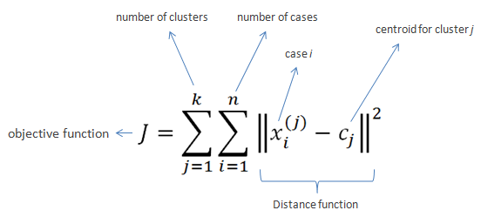
IMAGE SEGMENTATION MECHANISM CLUSTERING BASED APROACH
The objective of K-Means clustering
to minimize the sum of squared distances between all points and the cluster center

Slide 15
IMAGE SEGMENTATION MECHANISM CLUSTERING BASED APROACH
Choose the number of clusters K.
Select at random K points, the centroids (not necessarily from your dataset).
Assign each data point to the closest centroid → that forms K clusters.
Compute and place the new centroid of each cluster.
Reassign each data point to the new closest centroid. If any reassignment took place, go to step 4, otherwise, the model is ready

Slide 16
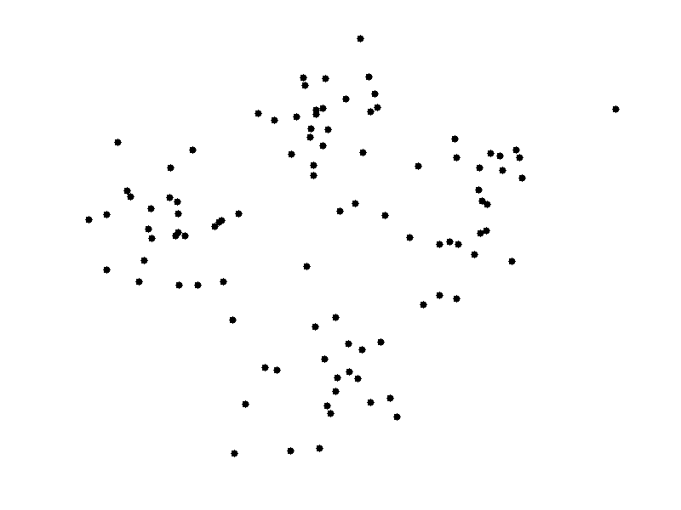
IMAGE SEGMENTATION MECHANISM CLUSTERING BASED APROACH

Slide 17
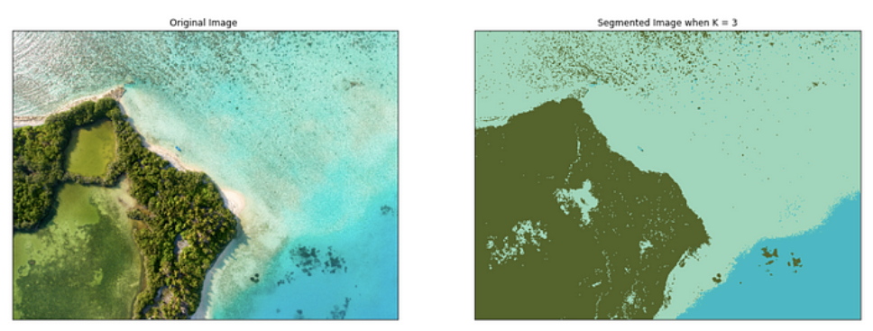
IMAGE SEGMENTATION MECHANISM CLUSTERING BASED APROACH

Slide 18
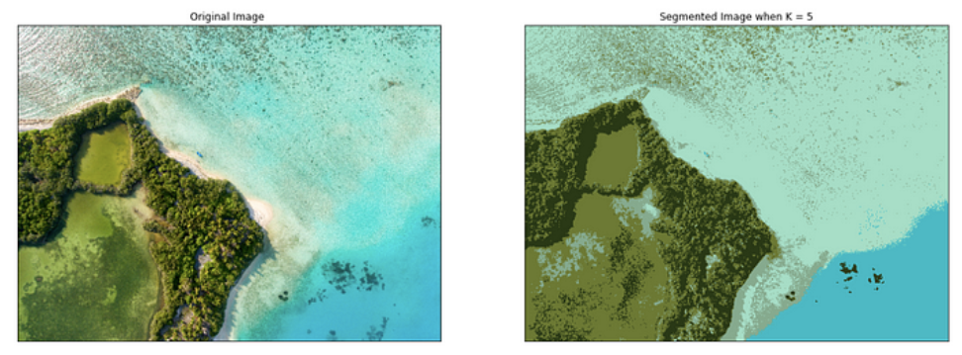
IMAGE SEGMENTATION MECHANISM CLUSTERING BASED APROACH

Slide 19
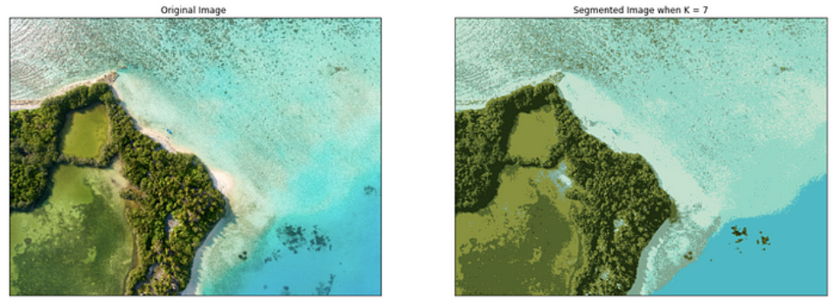
IMAGE SEGMENTATION MECHANISM CLUSTERING BASED APROACH

Slide 20
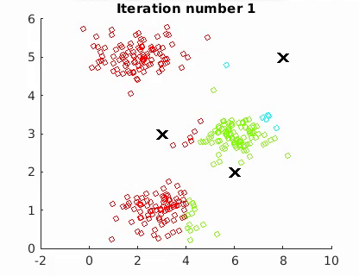
IMAGE SEGMENTATION MECHANISM CLUSTERING BASED APROACH

Slide 21
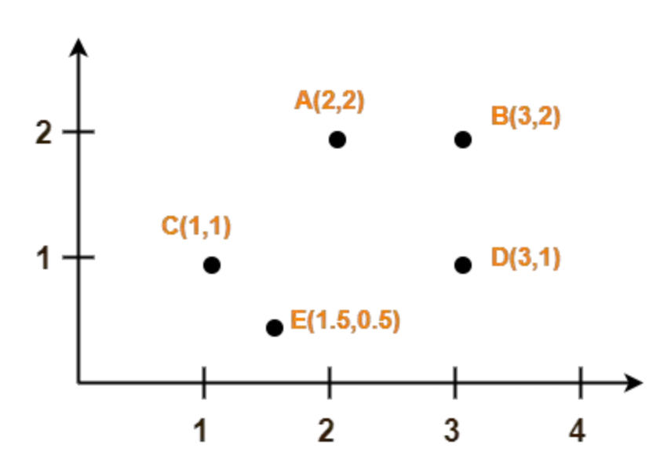
K-MEANS CLUSTERING - EXAMPLE
Use k-means to create 2 CLUSTERS

Slide 22
K-MEANS CLUSTERING - EXAMPLE
Center of 1st cluster C1
Use k-means to create 2 CLUSTERS
Assume A(2, 2) and C(1, 1)
centers of the two clusters
Use Euclidean distance
Center tof 2nd cluster C2

Slide 23
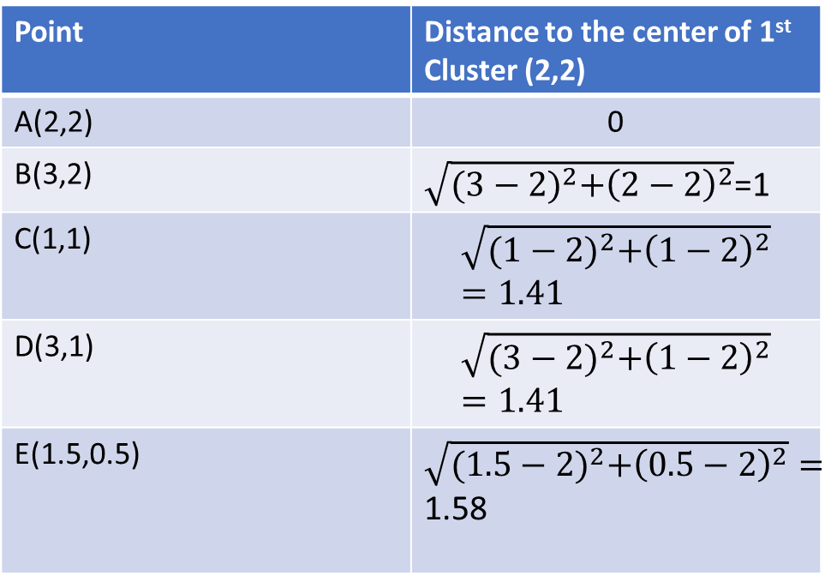
K-MEANS CLUSTERING - EXAMPLE
calculate the distance between each point and the centers of the two clusters
Point | Distance to the center of 1st Cluster (2,2)
A(2,2) | 0
B(3,2) | $\sqrt{{(3−2)}^{2}+{\left(2−2\right)}^{2}}$=1
C(1,1) | $$\sqrt{{(1−2)}^{2}+{\left(1−2\right)}^{2}}=1.41$$
D(3,1) | $$\sqrt{{(3−2)}^{2}+{\left(1−2\right)}^{2}}=1.41$$
E(1.5,0.5) | $\sqrt{{(1.5−2)}^{2}+{\left(0.5−2\right)}^{2}}=$ 1.58

Slide 24
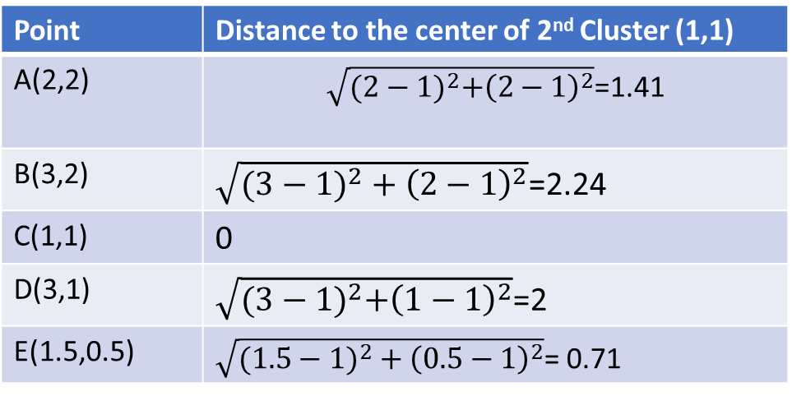
K-MEANS CLUSTERING - EXAMPLE
calculate the distance between each point and the centers of the two clusters
Point | Distance to the center of 2nd Cluster (1,1)
A(2,2) | $\sqrt{{(2−1)}^{2}+{\left(2−1\right)}^{2}}$=1.41
B(3,2) | $\sqrt{({3−1)}^{2}+{\left(2−1\right)}^{2}}$=2.24
C(1,1) | 0
D(3,1) | $\sqrt{{(3−1)}^{2}+{\left(1−1\right)}^{2}}$=2
E(1.5,0.5) | $\sqrt{({1.5−1)}^{2}+{\left(0.5−1\right)}^{2}}$= 0.71

Slide 25
K-MEANS CLUSTERING - EXAMPLE
Determine the closest centroid!
A belongs to the 1st cluster C1 → point A is closer to the centroid of the first cluster than the centroid of the second cluster (0 vs. 1.41).
B belongs to the 1st cluster C1
C belongs to the 2nd cluster C2
D belongs to the 1st cluster C1
E belongs to the 2nd cluster C2

Slide 26
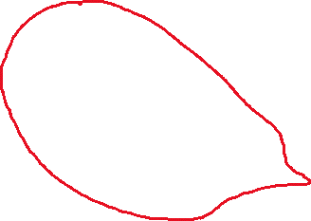
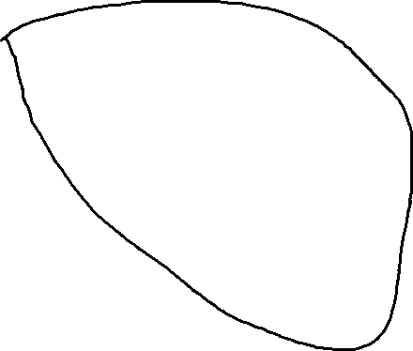
After first iteration
CLUSTER 1 C1
CLUSTER 2 C2

Slide 27
K-MEANS CLUSTERING - EXAMPLE
Calculate the new centroids of each cluster!
c(C1)=? and c(C2)=?
How?
By taking mean (averaging) of all the points contained in that cluster.
New centroids (centers of each cluster):
For C1: Points A, B, D → ((2+3+3)/3, (2+2+1)/3)=(2.67, 1.67)
For C2: Points C, E→ ((1+1.5)/2, (1+0.5)/2)=(1.25, 0.75)

Slide 28
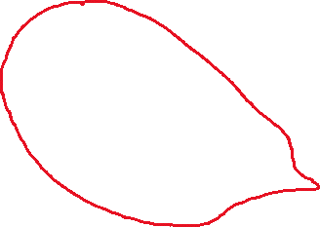

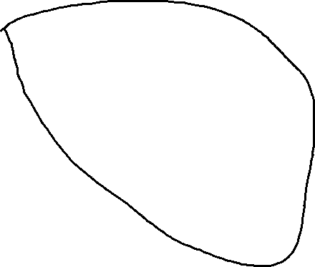
After first iteration New CENTROIDS
CLUSTER 1 C1
CLUSTER 2 C2
New centroid
(2.67,1.67)
New centroid
(1.25,0.75)

Slide 29
K-MEANS CLUSTERING - EXAMPLE
WHEN TO FINISH?
until the centers do not change anymore!

